Slide 1

Azure DevOps
Set up azure Devops bOARD
Code Mentor Mauritius – Azure DevOps Sessions – Full Stack Web Development

Slide 2
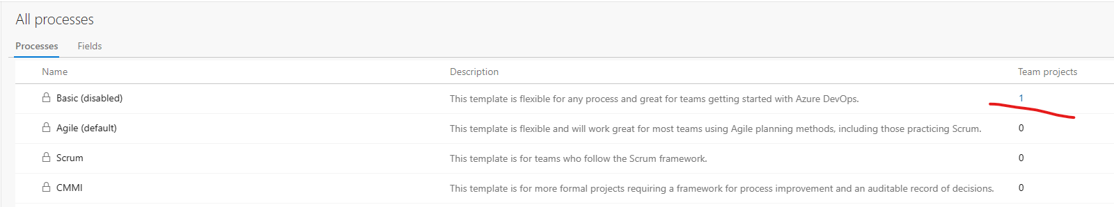
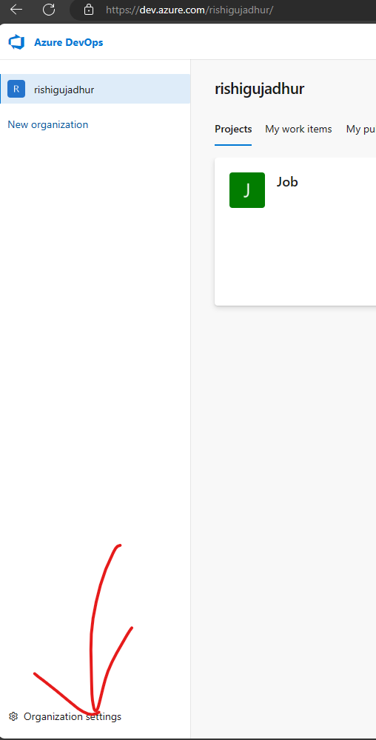
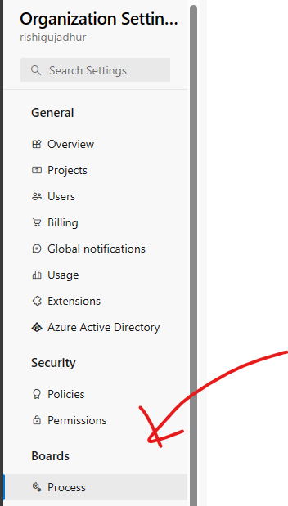
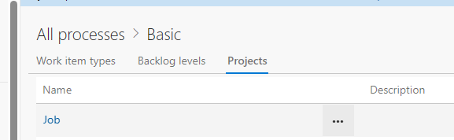
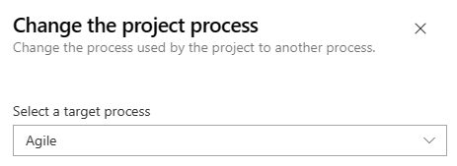
Setting Up Board – change process type
Azure DevOps Missing Feature and Story Items - YouTube
Code Mentor Mauritius – Azure DevOps Sessions – Full Stack Web Development

